Slide 1
NAME : ABIR DATTA EMAIL : abirdattabln07@gmail.com
TELECOM CUSTOMER CHURN ANALYSIS

Slide 2
Agenda
About the project: A detailed description of the project.
About the Data: Introduction to a dataset that has been used for the project.
Insights to find: What are the objectives & insights that are to be found out?
Steps for EDA & Cleaning Data: Various steps are used for data cleaning & EDA process.
Visual Analytics: Different visuals & summaries to understand data well.
Key Findings: Insights we find out according to various questions.
Dashboard View: The view of a dashboard that has been created.

Slide 3
About The Project
This project focuses on Telecom Customer Churn Analysis—an end-to-end data analytics and machine learning solution designed to help telecom companies reduce customer attrition.
Objectives:
1. Identify key factors leading to customer churn using historical data.
2.Visualize metrics, trends, and patterns interactively with Power BI dashboards.
3.Predict future churners through a machine learning approach (Random Forest).
Tools & Technologies:
1. SQL Server: For ETL (Extract, Transform, Load) and data preparation.
2.Power BI: For interactive analysis and business dashboarding.
3.Python (Google Colab): For building churn prediction models.
Business Value:
1.Empowers decision makers with actionable insights.
2.Enables targeted retention strategies based on both descriptive analytics and predictive modeling.
3.Delivers a robust, scalable framework applicable to any industry focused on customer loyalty.

Slide 4
About The Data
Dataset Source: Telecom customer dataset containing detailed customer demographic, geographic, account, and service information.
Number of Records: 6,418 customers tracked with historical join and churn data.
Key Variables:
Demographics: Gender, Age, Marital Status, State
Account Info: Contract Type, Payment Method, Tenure, Monthly Charges
Service Usage: Internet Service Type, Phone Service, Streaming Services, Device Protection
Financials: Total Revenue, Total Charges, Refunds, Extra Data Charges
Target Labels: Customer Status (Stayed, Churned, Joined), Churn Reason and Category

Slide 5
Steps For Data cleaning & Eda
Data Import & Initial Exploration:
Import data into SQL Server staging table.
Review column types and assess initial data quality.
Handling Missing Values:
Identify columns containing NULLs.
Replace NULLs with suitable default values or use imputation techniques.
Convert problematic data types (e.g., Bit to Varchar for seamless import).
Data Cleaning:
Remove duplicate records and irrelevant columns.
Standardize categorical variables (e.g., substitute blanks or nulls with "None" or "No").
Feature Engineering:
Create derived columns like "Churn Status" (binary flag).
Categorize continuous variables (e.g., Age Group, Monthly Charge Range, Tenure Group).
Exploratory Data Analysis (EDA):
Analyzed distributions of core variables (Age, Gender, Contract Type, State).
Calculated churn rates for different segments.
Used SQL queries and Power BI visualizations to uncover key patterns.

Slide 6
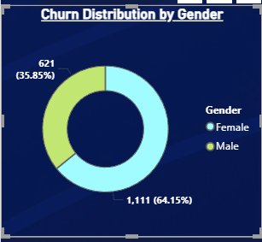
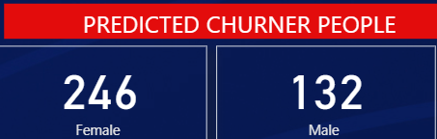
VISUAL ANALYTICS AND FINDINGS
Demographic Insights: Gender
According to the dashboard, there are 1,111 male customers who churned, making up 64.15% of total churn, and 621 female customers who churned, accounting for 35.85% of churn.
when predicting future churn, 246 females and 132 males are identified as high-risk, showing that more females are expected to churn going forward than males.

Slide 7
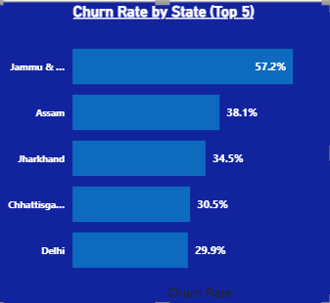
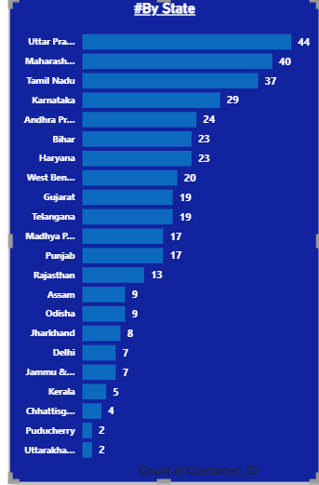
Geographic Insights: Churn Rate and Predicted Churn
Jammu leads with the highest churn rate at 57.2%, followed by Assam at 38.1%, Jharkhand at 34.5%, Chhattisgarh at 30.5%, and Delhi at 29.9%.
Looking at predicted churners, Uttar Pradesh is expected to have the most with 44, followed by Maharashtra with 40, Tamil Nadu with 37, Karnataka with 29, and Andhra Pradesh with 24.

Slide 8
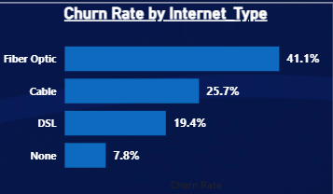
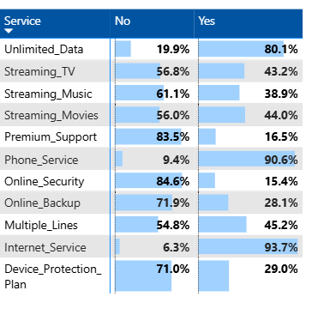
Churn Trends by Service Usage
Fiber Optic customers have the highest churn rate at 41.1%, followed by Cable at 25.7% and DSL at 19.4%, while those with no internet service have the lowest churn rate at 7.8%.
Among services, churn is dominant where customers have Internet Service (93.7%), Phone Service (90.6%), or Unlimited Data (80.1%).
Churned customers mostly do not use Premium Support (83.5%), Online Security (84.6%), Online Backup (71.9%), or Device Protection Plan (71.0%). Customers with streaming services also show high churn, with 56.8% for Streaming TV, 61.1% for Streaming Music, and 56% for Streaming Movies.

Slide 9
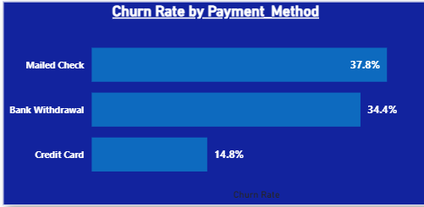
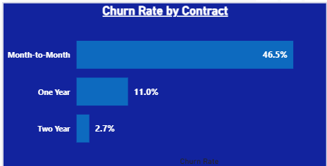
Churn Analysis by Account Information
Customers with month-to-month contracts have the highest churn rate at 46.5%, compared to 11.0% for one-year contracts and just 2.7% for two-year contracts. In terms of payment methods, mailed check users have a churn rate of 37.8%, bank withdrawal users 34.4%, while credit card users have the lowest churn rate at 14.8%.
This suggests that churn is much higher among customers with short-term contracts and those who pay by mailed check or bank withdrawal, whereas long-term contracts and credit card payments are associated with lower churn.

Slide 10
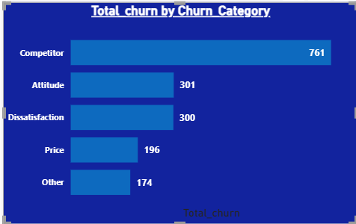
Churn distribution
.The leading cause of churn is customers switching to a competitor, accounting for 761 cases. Attitude and dissatisfaction each contributed to 301 and 300 churns, respectively, while price concerns caused 196 churns.
.There were 174 cases categorized as 'Other' reasons for churn. This shows that competition is the biggest driver of churn, followed by customer attitude, dissatisfaction with service, and pricing issues.

Slide 11
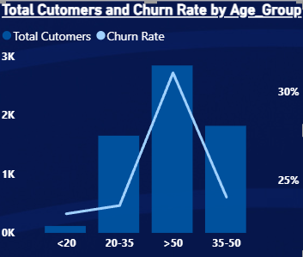
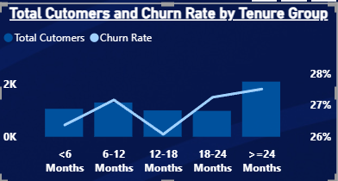
Churn Analysis by Age Group
In the age group analysis, customers over 50 have the highest churn rate and the largest number of total customers, whereas the 35-50 age group also has a substantial customer base but a lower churn rate. The 20-35 age group has fewer customers and an even lower churn rate, while those under 20 have the fewest customers and the lowest churn rate.
For tenure groups, customers with a tenure of more than 24 months have both the highest number of customers and the highest churn rate, above 27%. Other tenure groups (<6, 6-12, 12-18, and 18-24 months) show moderate customer numbers with churn rates fluctuating between approximately 26% and 27%. This suggests the risk of churn increases for customers who have been with the company longer.

Slide 12
Summary
During this analysis, the telecom company had 6,418 total customers, with 411 new joiners and 1,732 customers who churned, resulting in a churn rate of 27%.
Males accounted for 1,111 churned customers (64.15%) and females 621 (35.85%).
The highest churn rates were observed among customers with month-to-month contracts (46.5%), fiber optic internet users (41.1%), and those paying by mailed check (37.8%).
Jammu recorded the highest churn rate by state at 57.2%.
Competitor switch was the top reason for churn, affecting 761 customers.

Slide 13
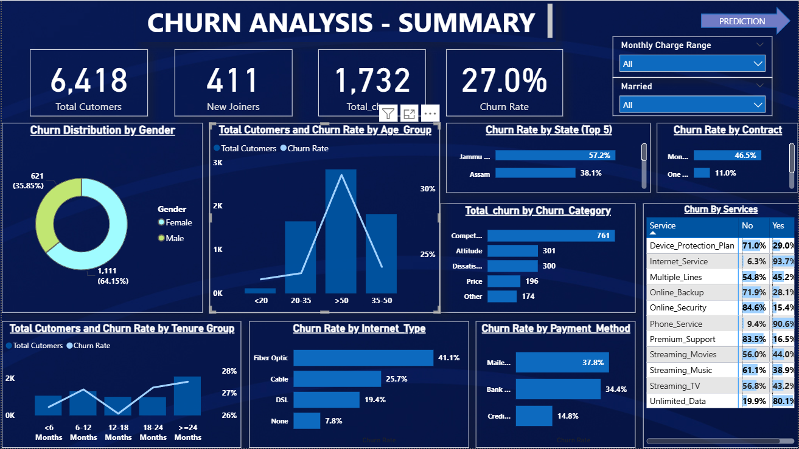

Slide 14
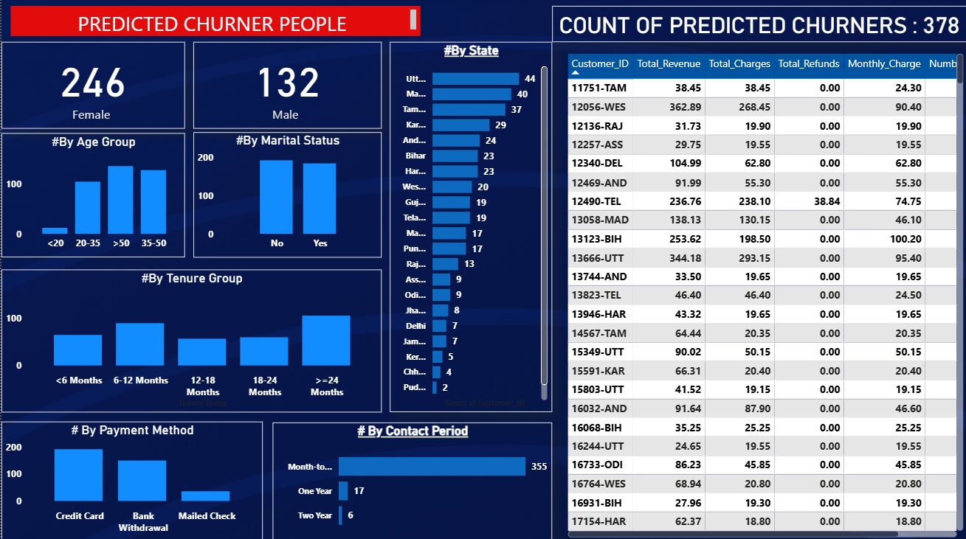

Slide 15
THANK YOU
Email:abirdattabln07@gmail.com Linked in :https://www.linkedin.com/in/abir-datta-02875323a/

